Slide 1


AIBridge
Lecture 5
Notes:
Going over last week’s lab
How to improve results
prepare to discuss lab 4 key

Slide 2
Let’s talk about the last lab!
Notes:
Let’s first start by reviewing last week’s lab.

Slide 3
What circumstances made the model fit better?
Let’s talk about the last lab!
what does this even mean?
worse?
Notes:
There were some changes you could have made that would make your model better, (click) and some that would make it worse.
But first, (click) what does a better model even mean? I guess you could say a better model is one where the loss keeps going down, but loss is a bit of an abstract quantity. it’s hard to intuitively get a sense of what loss represents.
For example, if you think back to last week’s classes, (click) we mentioned that one way to measure loss is through the squared sum of all the distances from each point to the line. I don’t know about you but that’s pretty hard for me to visualize.

Slide 4
Accuracy
“Why is it not enough?”
Notes:
So, there should be some way to easily and intuitively measure how good a model is performing. Something called accuracy is fairly common, and you’ve probably seen accuracy show up in, say a covid test.
But there’s also these other two ways that I want to mention. (click) Precision and recall. Now, there’s always the assumption that accuracy is good enough to quantify everything, but I hope I can convince you otherwise today in this lecture.
Let’s begin by exploring each of these 3 metrics.

Slide 5
Accuracy
, Precision, and Recall
Notes:
So, there should be some way to easily and intuitively measure how good a model is performing. Something called accuracy is fairly common, and you’ve probably seen accuracy show up in, say a covid test.
But there’s also these other two ways that I want to mention. (click) Precision and recall. Now, there’s always the assumption that accuracy is good enough to quantify everything, but I hope I can convince you otherwise today in this lecture.
Let’s begin by exploring each of these 3 metrics.

Slide 6
“Selection space”
Notes:
So here (click) is a funny little shape. Let’s call it the selection space (click).
This entire rectangle represents all of the results our model gives us.
Let me give an example. Let’s say our model has to predict whether or not a person has covid. Yes or no, so this is classification. This entire rectangle represents all the decisions our models makes, positive or negative, on the patients that we run through the model.
First, we start with the small light green triangle. Here, the small green triangle represents…

Slide 7
“Selection space”
Notes:
So here (click) is a funny little shape. Let’s call it the selection space (click). Some of you might be very familiar with this concept, although called differently, which I will connect later. If so, feel free to zoom out a bit. This is really important stuff here, so we will need to cover it.
This entire rectangle represents all of the results our model gives us.
Let me give an example. Let’s say our model has to predict whether or not a person has covid. Yes or no, so this is classification. This entire rectangle represents all the decisions our models makes, positive or negative, on the patients that we run through the model.
First, we start with the small light green triangle. Here, the small green triangle represents…

Slide 8
Model selects positive and patient is positive
“Selection space”
Notes:
…all the cases when our model classifies a patient as positive and the patient is indeed positive. So light green triangle is when our model did its job correctly.
The small light red section…

Slide 9
Model selects positive and patient is positive
Model selects positive and patient is negative
“Selection space”
Notes:
…represents all the times where our model classifies a patient as positive and the patient is actually negative. So light red triangle is when our model did its job incorrectly.
Next up is the big dark green shape,…

Slide 10
Model selects negative and patient is negative
Model selects positive and patient is positive
Model selects positive and patient is negative
“Selection space”
Notes:
…which represents cases where our model classifies a patient as negative and the patient is indeed negative. So a big dark green shape is when our model did its job correctly.
Lastly, the big dark red shape…

Slide 11
FN: Model selects negative and patient is positive
TP: Model selects positive and patient is positive
FP: Model selects positive and patient is negative
TN: Model selects negative and patient is negative
“Selection space”
Notes:
Ok great! Let’s now tackle precision. (Click)

Slide 12
TRUE POSITIVE
FALSE NEGATIVE
FN: Model selects negative and patient is positive
TP: Model selects positive and patient is positive
FALSE POSITIVE
TRUE NEGATIVE
FP: Model selects positive and patient is negative
TN: Model selects negative and patient is negative
“Selection space”
Notes:
Alright, so all those fractions with triangles and notched rectangles we just covered do actually translate over into actual equations, and here they are.
The green triangle represents true positives (click), the red triangle represents false positives (click), the green rectangle represents a true negative (click), and the red rectangle represents a false negative(click).

Slide 13
“Number of cases where we chose positive when patient is positive
and
Number of cases where we chose negative when patient is negative”
Accuracy
Overall ability of model
“Everything”
Notes:
Accuracy is, (click, read), (click, read.)
Meaning, it is the measure of the overall ability of our model — the number of cases where it was correct divided by the total number of cases, TAKE QUESTIONS (click.)
You may be able to spot a potential issue already, which is that this equation is a bit naive. It sidesteps a lot of the complexity of the classification by only worrying about big picture information.
But don’t get me wrong, accuracy has plenty of use cases. For example, in last week’s lab, the accuracy number is actually what we got from using classifier.score

Slide 14
FN: Model selects negative and patient is positive
TP: Model selects positive and patient is positive
FP: Model selects positive and patient is negative
TN: Model selects negative and patient is negative
“Selection space”
Accuracy
Overall ability of model
Notes:
Ok great! Let’s now tackle precision. (Click)

Slide 15
“Number of cases where we chose positive when patient is positive”
Precision
Amount of selection that’s actually correct.
“All selected positive by the model”
Notes:
In the case of precision, we have, (click, read), (click, read.)
Meaning, it is the measure of the, well, preciseness of the model. (click)
Notice how all the terms here are triangles. Triangles represent times when our model selects positive. Essentially, this equation boils down to: “when we select positive, how often is that correct?” TAKE QUESTIONS

Slide 16
FN: Model selects negative and patient is positive
TP: Model selects positive and patient is positive
FP: Model selects positive and patient is negative
TN: Model selects negative and patient is negative
“Selection space”
Precision
Accuracy
Amount of selection that’s actually correct.
Overall ability of model
Notes:
Ok great! Let’s now tackle precision. (Click)

Slide 17
“Number of cases where we chose positive when patient is positive”
Recall
Amount of what needs to be selected that is selected
“All cases that are positive”
Notes:
For recall, it is (click, read), (click, read).
This is a measure of how much of what we need to select is actually selected. (click)
That probably didn’t make sense, let me explain a bit more. The pattern here is slightly harder to spot: its that all the shapes involved in this equation represent cases where the patient is positive.
Recall essentially boils down to “when there’s a patient that’s positive, how often can we recognize it?”
TAKE QUESTIONS (click)

Slide 18
FN: Model selects negative and patient is positive
TP: Model selects positive and patient is positive
FP: Model selects positive and patient is negative
TN: Model selects negative and patient is negative
“Selection space”
Precision
Recall
Accuracy
Amount of selection that’s actually correct.
Amount of what needs to be selected that is selected
Overall ability of model
Notes:
So, let’s summarize. Accuracy is the overall ability of the model. Precision is the amount of the selection that’s actually correct. Recall is the amount of what needs to be selected that’s actually selected. TAKE QUESTIONS. (click).
TRANSITION SLIDE NO TOUCHIE

Slide 19
“Selection space”
“Selection space”
Notes:
Let’s explain the three metrics in the context of a classification problem. Since it’s relevant, let’s say we are trying to determine whether or not a certain patient has covid using some AI model. This is an example of a classification problem.
Here is a funny little shape. Let’s call this entire rectangle the selection space (click) — meaning the set of all the covid testing samples in existence. The large green rectangle…

Slide 20
All positive samples
“Selection space”
“Selection space”
Notes:
…is the space of all positive cases. This represents all the cases where the sample from the patient does actually contain covid.
The large red rectangle…

Slide 21
All positive samples
All negative samples
“Selection space”
“Selection space”
Notes:
…is the space of all negative cases. (click) This represents all the cases where the sample from the patient does not contain covid.

Slide 22
All positive samples
All negative samples
“Selection space”
“Selection space”
Notes:
Of all the covid samples in existence, we’re only going to focus on this small section (click). This smaller black square represents the portion of all the samples that we will run through our model. This is the section we will focus on.
I’m going to split this section into 4 different parts. Each of the 4 parts are different from the rest.

Slide 23
All positive samples
All negative samples
“Selection space”
“Selection space”
Notes:
And we get this.
The 2 light green regions on the left…

Slide 24
What our model selected as positive
All positive samples
All negative samples
“Selection space”
“Selection space”
Notes:
…are all the cases where our model classified the sample as positive.
Notice how the two are subtly different.
The green triangle with the green border represents the cases where our model classified the positive sample as positive.
The green triangle with the red border represents the cases where our model classified the negative sample as positive.
And last, the 2 light red regions on the right…

Slide 25
What our model selected as positive
All positive samples
All negative samples
What our model selected as negative
“Selection space”
“Selection space”
Notes:
…are all the cases where our model classified the sample as negative.
Once again, notice how the two are subtly different.
The red triangle with the green border represents the cases where our model classified the positive sample as negative.
The red triangle with the red border represents the cases where our model classified the negative sample as negative.
take questions
Okay. Now we can start discussing the 3 metrics we introduced at the start. First, accuracy.

Slide 26
“Number of things that we should select that we did select and the number of things that we shouldn’t select that we didn’t select.”
Accuracy
Overall ability of model
“Out of everything”
Notes:
Accuracy is, (click, read), (click, read.) Meaning, it is the measure of the overall ability of our model — both its ability to (click) select things it should select, and its ability to not select things it shouldn’t select, TAKE QUESTIONS (click.)
This should be the number your algorithm gave you yesterday.
The number of correctly selected things over the total amount of samples.

Slide 27
“Selection space”
“Selection space”
Accuracy
Overall ability of model
Notes:
Great! Let’s now tackle precision. (Click)

Slide 28
“Number of things that we should select that we did select”
Precision
“Number of things that we should select that we did select and the number of things that we shouldn’t select that we did select.”
Amount of selection that’s actually correct.
Notes:
In this case, we have, (click, read), (click, read.) Meaning, it is the measure of the, well, preciseness of the model — concerning itself with measuring how much of what we selected is actually what we should select (click). TAKE QUESTIONS

Slide 29
“Selection space”
“Selection space”
Accuracy
Precision
Amount of selection that’s actually correct.
Overall ability of model
Notes:
Excellent! Finally, let’s take a look recall. (Click)

Slide 30
“Number of things that we should select that we did select”
Recall
Amount of what needs to be selected that is selected
“Number of things that we should select in total”
Notes:
For recall, (click, read), (click, read.), essentially (click), this is the measure of how much of what we need to select that is actually selected. TAKE QUESTIONS (click)

Slide 31
“Selection space”
“Selection space”
Accuracy
Precision
Recall
Amount of selection that’s actually correct.
Amount of what needs to be selected that is selected
Overall ability of model
Notes:
So, let’s summarize. Accuracy is the overall ability of the model. Precision is the amount of the selection that’s actually correct. Recall is the amount of what needs to be selected that’s actually selected. TAKE QUESTIONS. (click).
TRANSITION SLIDE NO TOUCHIE

Slide 32
TRUE POSITIVE
FALSE NEGATIVE
FALSE POSITIVE
TRUE NEGATIVE
Accuracy
Precision
Recall
Amount of selection that’s actually correct.
Amount of what needs to be selected that is selected
Overall ability of model
Notes:
Alright, so all those fractions with triangles and notched rectangles we just covered do actually translate over into actual equations, and here they are.
The green triangle represents true positives (click), the red triangle represents false positives (click), the green rectangle represents a true negative (click), and the red rectangle represents a false negative(click).

Slide 33
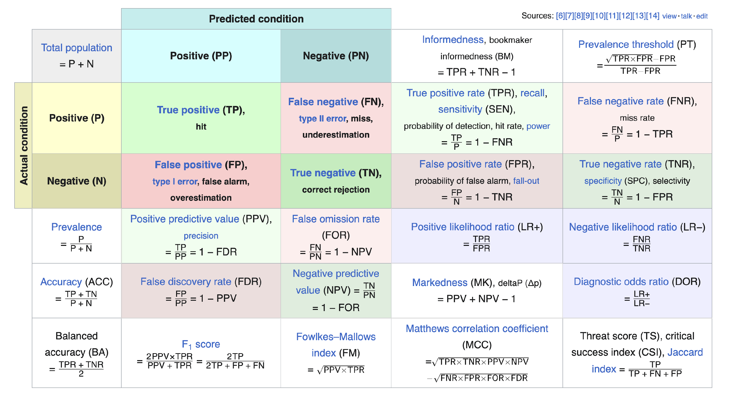
https://en.wikipedia.org/wiki/Precision_and_recall
Notes:
We are

Slide 34
 | Predicted Positive | Predicted Negative
Actually Positive | TP | FN
Actually Negative | FP | TN
Accuracy
Precision
Recall
Notes:
And here’s a useful table that explains what each term means.
Ok, that was a lot of information, any questions?
Alright, so let’s explain why you should care about all this. (click)

Slide 35
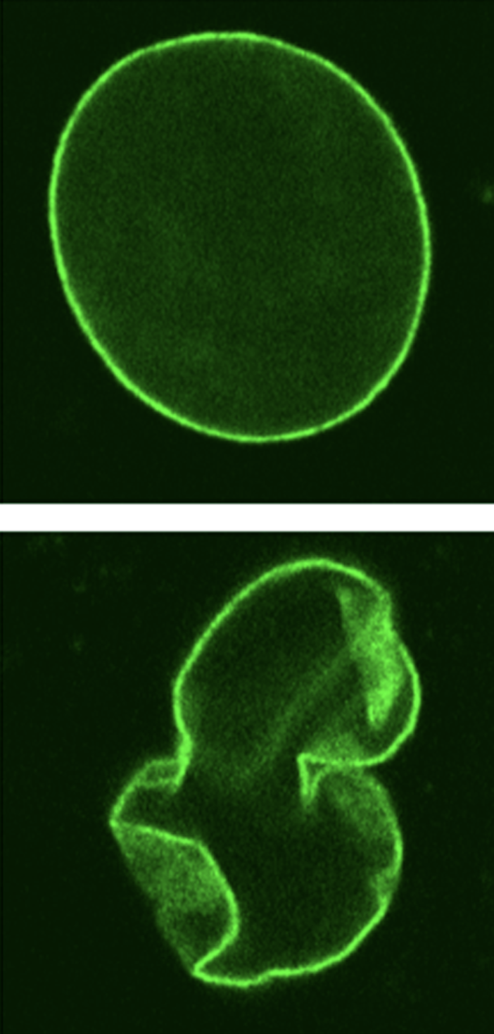
Progeria affects ~159 patients in the US
we have a dataset of all American pediatric patients
Q: If my model predicts with 99.99% accuracy, is it good enough?
Notes:
Progeria is an extremely rare disease that affects just over a hundred patients in the US. Progeria can be identified by the deformed nucleus within a cell. So, (click) let’s say we have a dataset of ALL the hundreds of millions of American pediatric patients…

Slide 36
protein shape
Model
progeria
(yes or no)
Progeria affects ~159 patients in the US
we have a dataset of all American pediatric patients
Notes:
We want to determine if any of the hundreds of millions of patients have progeria, so, we make a model that predict, either yes or no, whether a patient has progeria.

Slide 37

a proposed model:
Model
no progeria regardless
protein shape
actually pretty accurate!
Progeria affects ~159 patients in the US
we have a dataset of all American pediatric patients
Notes:
Now, let me propose a hypothetical model. Lets say, in this model, we take in all the data for one patient, including the nucleus structure, height, allergies, and all other biometrics. And, instead of doing some heavy computations, we just always output (click) no. No progeria. This seems strange, that’s a horrible model. And you would be correct, it doesn’t do anything. However, when we calculate its accuracy, (click) it’s nearly 100%.

Slide 38
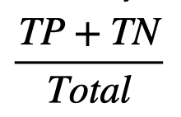
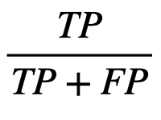
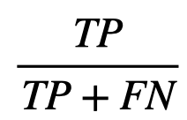

Accuracy
Overall ability of model
exactly zero
Model
no progeria regardless
Precision
Amount of selection that’s actually correct.
Progeria affects ~159 patients in the US
Recall
we have a dataset of all American pediatric patients
Amount of what needs to be selected that is selected
scaled properly!
Notes:
Lets think back to those three equations we talked about earlier. The number of true positives in this case would be (click) exactly zero since our model never chooses yes. However, the number of true negatives is in the hundreds of millions. These are the patients that don’t have progeria that our model correctly identified as not having progeria. In this case here, we see that our accuracy will be basically equal to 1, or 100%, despite having a completely useless model. Instead, what we should have used is recall (click), which takes the number of true positives, which is zero in this case, and divides it by the number of true positives and false negatives. The recall of our model is, 0%, which is a much better representation of this hypothetical model.
* in different cases, you should use different metrics

Slide 39
storytime!
Notes:
transition over to prof. liu

Slide 40
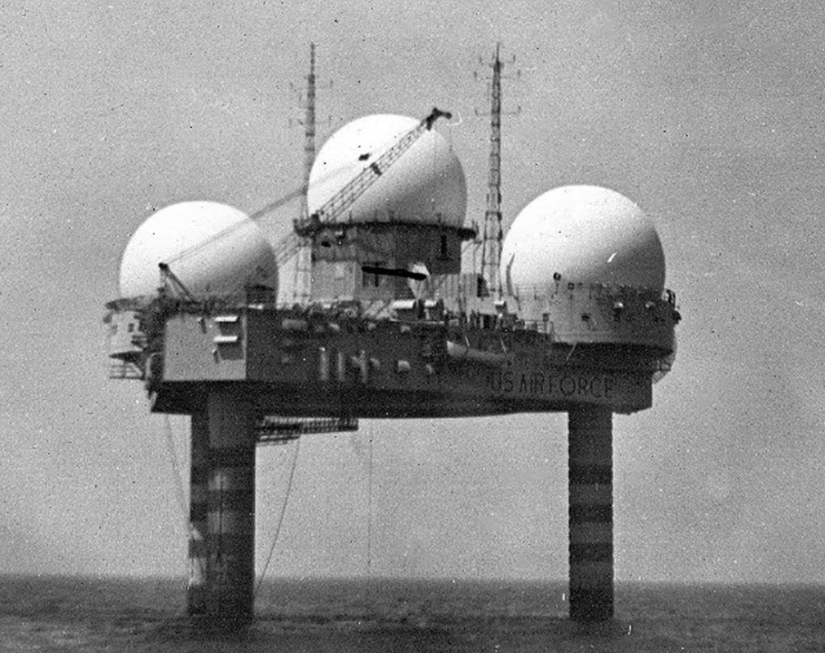
storytime!

Slide 41
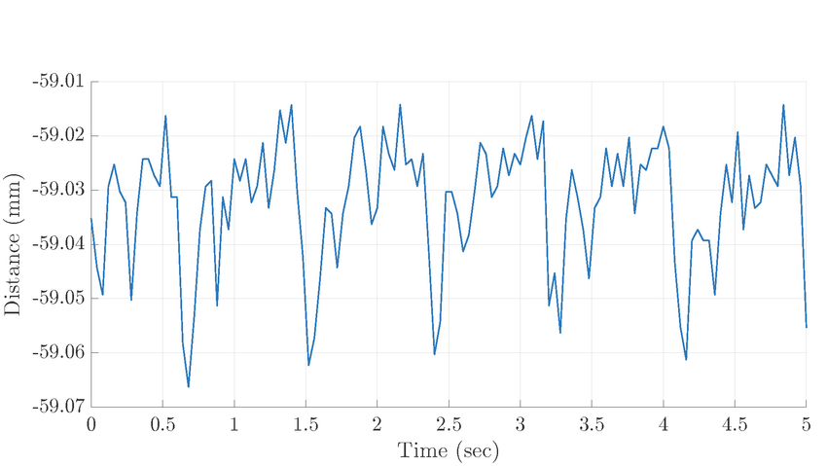

storytime!
does this count as detection?
Notes:
Radar technology started in WWII, During its early development in WWII, radar played a pivotal role in detecting and intercepting enemy aircraft, greatly improving the effectiveness of air defense systems. Radar detects aircraft by emitting radio waves that bounce off the aircraft and return to the radar antenna, allowing the radar to determine the location, speed, and direction of the aircraft.

Slide 42
storytime!
“threshold”
high recall, low precision
Notes:
why is it that high recall no precision?

Slide 43
storytime!
“threshold”
high precision, low recall
Notes:
why

Slide 44
quantifying
“threshold”
Notes:
why

Slide 45
quantifying
ROC Curve!
“threshold”
Notes:
why

Slide 46

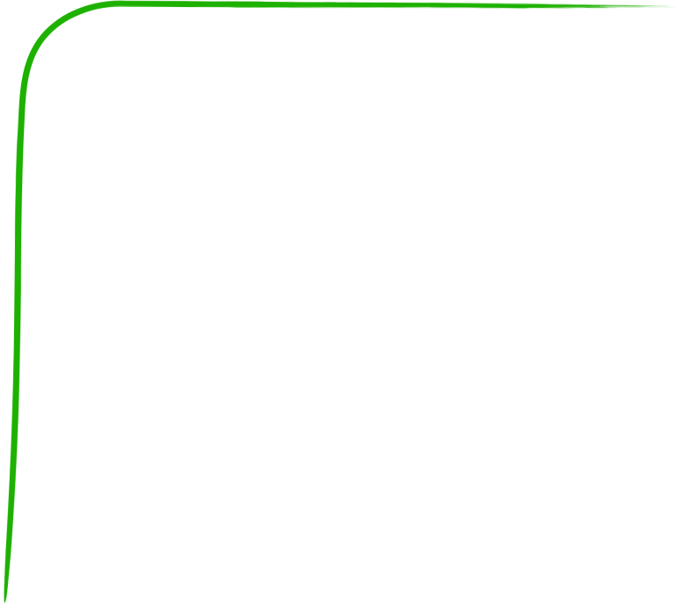

Great!
“Random”
True Positive
ROC Curve!
Receiver Operation Curve
need lots of false positives before detecting a true positive
Awful.
False Positive
ROC Curve quantify the amount of “error”/noise that is necessary for a classifier to make a good prediction
Notes:
it stands for reciever operation curve, which I think is super cool

Slide 47
Great!
True Positive
AUC
area under [the ROC] curve
Q: how do you compare these points
False Positive
AUC and also Precision-Recall Area Under Curve (PR AUC).
Notes:
Take questions, transition back to Jiaming’s section.

Slide 48
more data
what makes models fit better
balanced data
normalized data
quality data
Notes:
Ok, so after all this, what actually makes a model fit better? It all has to do with data. There’s a common principle in computer science: garbage in, garbage out. If you don’t have good inputs, then you shouldn’t expect your outputs to be any good either. You can get better inputs by (click) adding more data, (click) balancing your data, (click) or normalizing your data.

Slide 49
more data
balanced data
normalized data
quality data
Notes:
(click) Let’s focus first on adding more data (click).

Slide 50
more data
balanced data
normalized data
quality data
Notes:
(click) Let’s focus first on adding more data (click).
if data isn’t perfect: small # of datapoints=more fluctuation, more datapoint s=less fluctuation

Slide 51
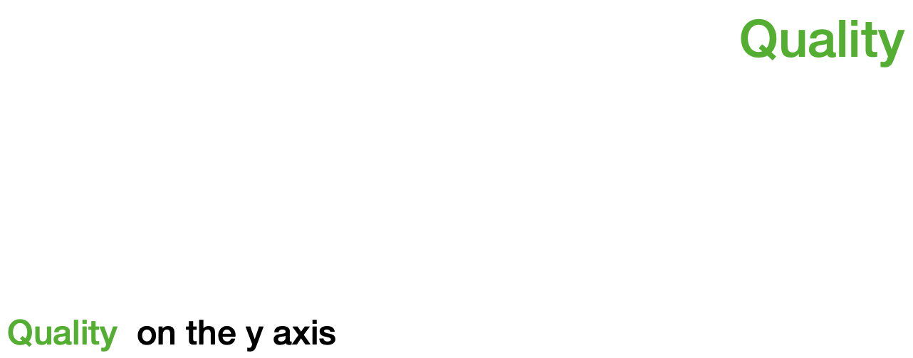
more data
let’s say we have a simpler wine dataset
Acidity on the x axis
Acidity
Notes:
Let’s think back to the wine dataset, and for simplicity sake we only consider two things:
(click) Wine Quality, which we will graph on the y-axis. Remember, this is what our model is trying to predict.
(click) Wine Acidity, which we will graph on the x-axis. This is what our model will take in as input.
If we try to train our model with only, let’s say 3 datapoints, it won’t perform particularly well for various reasons.

Slide 52
more data
Acidity on the x axis
Notes:
Maybe the few data points we used for training happened to be outliers or maybe their data is inaccurate like this example demonstrates. Then the result will be a model that is completely unusable.

Slide 53
more data
Acidity on the x axis
Notes:
TRANSITION SLIDE

Slide 54
more data
Acidity on the x axis
Notes:
Or maybe the few points that were used don’t tell the whole story about the dataset. The result here is that the model doesn’t generalize to the underlying trend of a set of data.

Slide 55
more data
Acidity on the x axis
Notes:
So how do you fix not having enough data? Well, simply add more data. (click) So long as the data is collected and used consistently, adding more data for your model to train on will generally improve its performance.

Slide 56
more data
Acidity on the x axis
use more data, get more accurate results
Notes:
So how do you fix not having enough data? Well, … simply add more data. (click) So long as the data is collected and used consistently, adding more data for your model to train on will generally improve its performance. (click)
One extra thing to note is that you don’t always have to go out and collect more data to increase the amount of data. There is a technique called Data Augmentation where you can adjust already existing samples of data to generate additional samples. For example, if your dataset has images, maybe you adjust the contrast or saturation of the image or flip the image horizontally or maybe crop off an edge of the image. However, this isn’t really possible for the dataset’s we’re using.

Slide 57
more data
balanced data
normalized data
quality data
Notes:
(click) Let’s focus first on adding more data (click).
if data isn’t perfect: small # of datapoints=more fluctuation, more datapoint s=less fluctuation

Slide 58
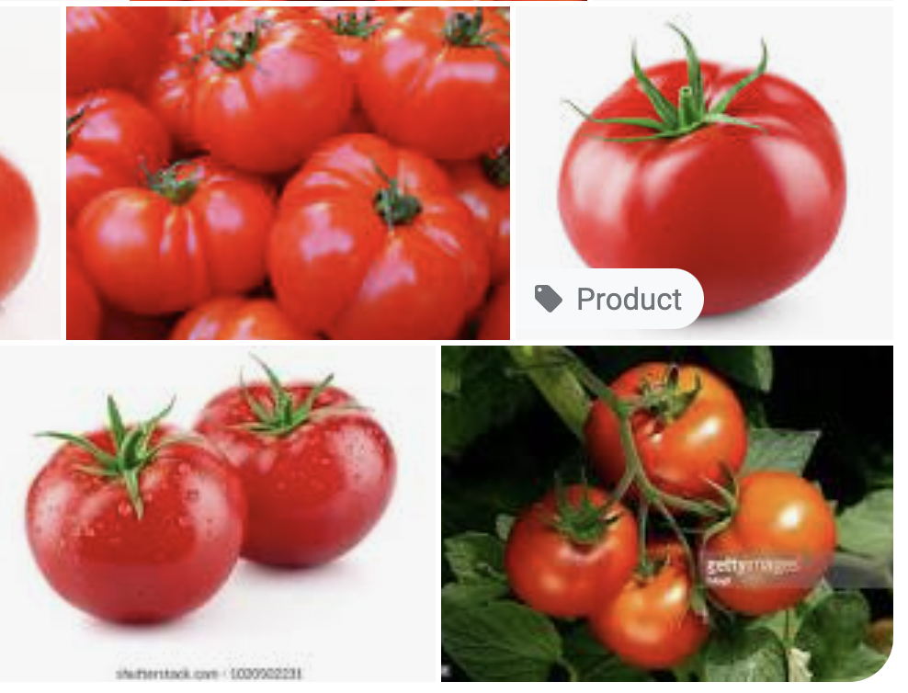
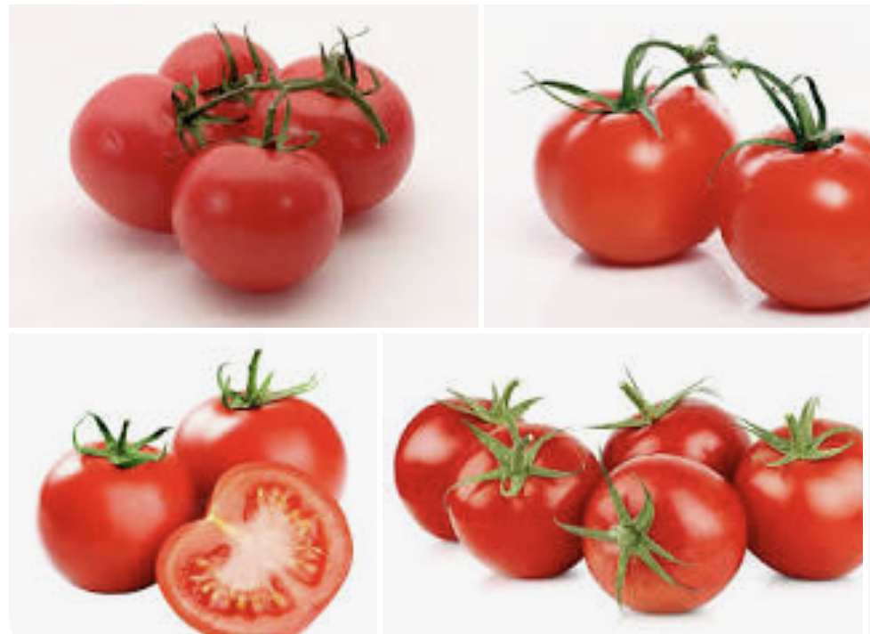

Slide 59
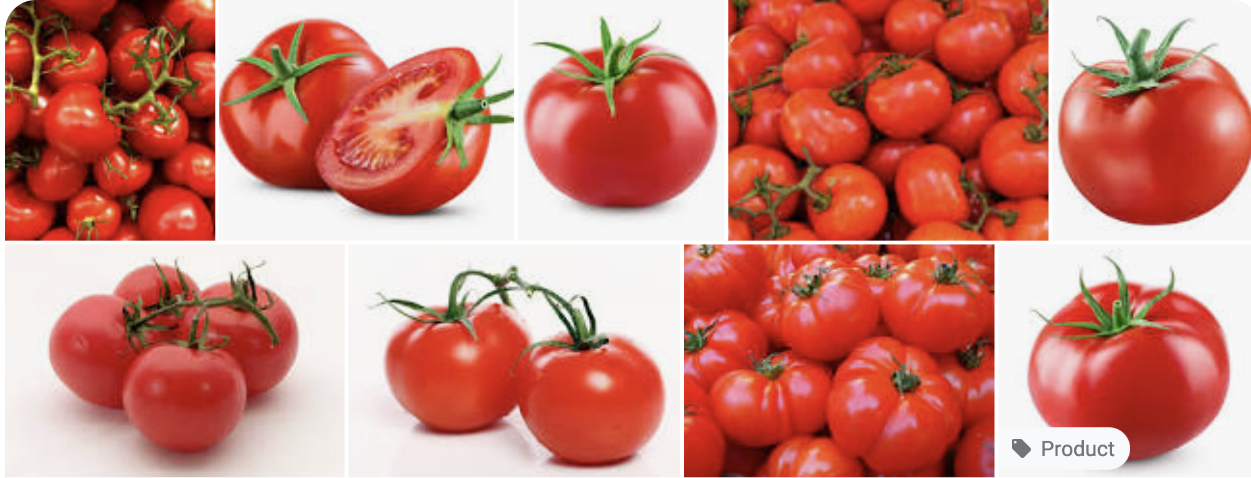
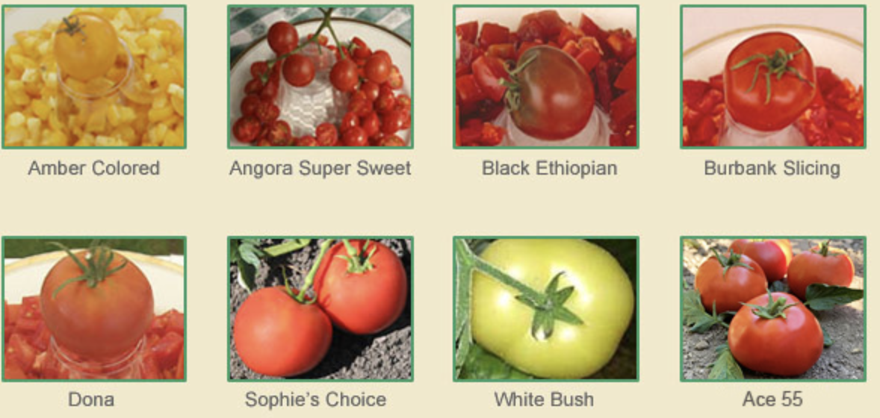

Slide 60
more data
balanced data
normalized data
quality data
Notes:
(click) Let’s focus first on adding more data (click).
if data isn’t perfect: small # of datapoints=more fluctuation, more datapoint s=less fluctuation

Slide 61

more data
that’s linear(ish)*
Model
a reminder…
models are functions
Notes:
(click) As a quick reminder, (click) models are R n to R m functions. N inputs, N outputs.

Slide 62
more data
Quality
that’s linear(ish)*
Acidity
Notes:
*change graphics, remove box

Slide 63
more data
Quality
??? still not super well described
Acidity
Notes:
*show line wiggling

Slide 64
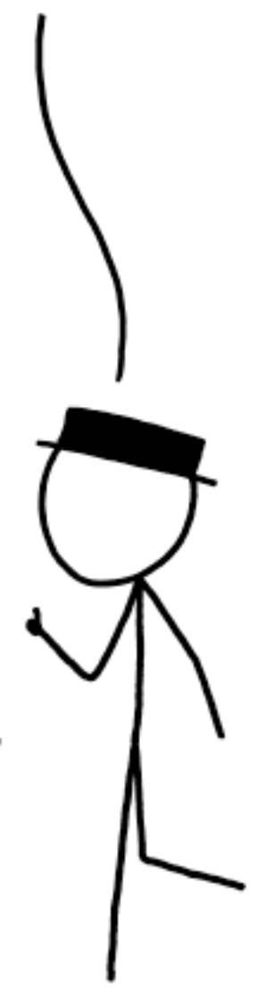
more data
Quality
But, can we formalize it?
much better!
Acidity
Notes:
* more data, the more likely our model will generalize to the data

Slide 65

more data
Quality
kind of a random variable!
Acidity

Slide 66

more data
Quality
wait… this is a t-test!
Acidity

Slide 67
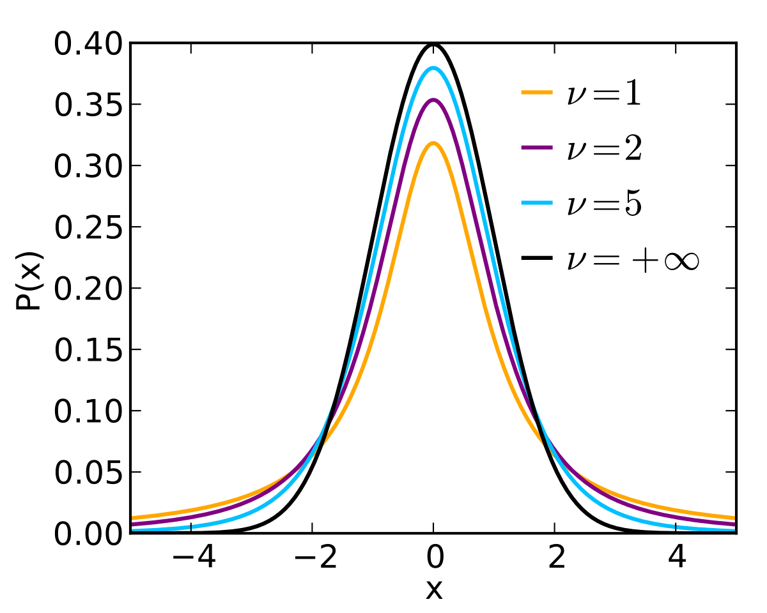

more data
Quality
Acidity

Slide 68

more data
Quality
Acidity

Slide 69

more data
Quality
Acidity

Slide 70

more data
Quality
Acidity
increased degrees-of-freedom increases the probability of the population equaling sample

Slide 71
more data
Quality
Acidity
increased degrees-of-freedom increases the probability of the population equaling sample
more data, better line
Notes:
We have some statistical assumption here!
We are assuming that our data is uniformly, randomly drawn
IF we meet for conditions for inference, this works. If NOT, we will address this more during data bias lecture in the end.
E.g. davis weather can’t predict global weather

Slide 72
more data
balanced data
normalized data
quality data
Notes:
(click) Let’s focus first on adding more data (click).
if data isn’t perfect: small # of datapoints=more fluctuation, more datapoint s=less fluctuation

Slide 73
Let’s think about logistic functions!
balanced data
Notes:
(click) and a bit of logistic functions (click).

Slide 74
Let’s think about logistic functions!
balanced data
White
Red
in an ideal world
…but no
Notes:
In an ideal world (click), we would have a perfectly even balance of data. For the wine dataset, it would be exactly 50% white wine and 50% red wine. Unfortunately (click), we don’t live in a perfect world (click).

Slide 75
Let’s think about logistic functions!
balanced data
4898
1599
White
Red
What happens when we fit this dataset entirely?
Notes:
In reality, the dataset looks something like this.
(click) 5000 samples of white wine,
(click) but only 1600 samples of red wine.
(click) so, what are the consequences of this uneven split? Let’s see what happens when a logistical model tries to fit this dataset.

Slide 76

Let’s think about logistic functions!
balanced data
Red
White
pretty well defined!
Acidity
Notes:
(click) {line 1}
(click) {line 2}
(click) {line 3}
In this exaggerated picture, we have 3 possible ways a model can conceivably fit this dataset. In the bottom left here,
(click) you see there’s a lot of data points representing white wine, so the line is pretty well defined here. Visually, this means all the lines are closer together.

Slide 77

Let’s think about logistic functions!
balanced data
Red
much more divergent
White
pretty well defined!
Acidity
balanced data, more accurate results
Notes:
In the top right however, you can see that the lines are a lot more divergent.
(click) You can think of this from the model’s perspective, it wants to minimize the total distances to every point. So, the easiest way for it to decrease the total distances is to bend more around the white wine data where more of the points are, and it can care less about the red wine because there’s less points.
(click) In general, the more balanced your data is, the more accurate your model will be.

Slide 78
more data
balanced data
normalized data
quality data
Notes:
(click) Let’s focus first on adding more data (click).
if data isn’t perfect: small # of datapoints=more fluctuation, more datapoint s=less fluctuation

Slide 79
more data
balanced data
normalized data
quality data
Notes:
(click) Let’s focus first on adding more data (click).
if data isn’t perfect: small # of datapoints=more fluctuation, more datapoint s=less fluctuation

Slide 80
normalized data
Acidity
120
90
60
30
Sulfur Dioxide
30
60
90
120
Notes:
Here’s another hypothetical dataset. We have the Sulfur Dioxide of the wine on the x-axis and the quality of the wine on the y-axis. There are two classes of wine here, red and wine, each labeled with its corresponding color.
The goal here is a bit different from the normal regression problem. Here we want to fit a line that best separates the two classes.
We can see that the numbers for residual sugar are a lot larger than that for wine quality: Wine acidity only goes up to a maximum of 10 while residual sugar can go up to about 120.
There’s a problem here, and it may not be obvious at first, but it’s important. To demonstrate, let’s once again try to fit this data with a line that best separates the two classes.

Slide 81
normalized data
Acidity
120
x - 3y > 50
True == Red
False == White
???
90
60
30
Sulfur Dioxide
30
60
90
120
Notes:
And here’s what the separation line looks like.
Ok, nothing terrible right?
But let’s get the equation of that line (click), and here’s where problems start happening.
It looks something like this. That constant for y is 3, which is disproportionately large in comparison to the constant of x, which is just 1. This basically means that Acidity has a larger impact on the output of the model simply because its numbers have a larger range.
This may be fine when we only have 2 variables, but as we add even more dimensions, the Acidity value is going to drown out the values of any other input we add.
So how do we solve this? Once again, it has to do with our data. We need to re-distribute our data but instead using a smaller range of numbers. Let’s say we want all our data to be distributed between 0 and 1. (click)

Slide 82
normalized data
Acidity
120
90
60
30
Sulfur Dioxide
30
60
90
120
Notes:
Once again, it has to do with our data. We need to re-distribute our data but instead using a smaller range of numbers. Let’s say we want all our data to be distributed between 0 and 1. (click)

Slide 83
normalized data
Acidity
1.2x - y > 0.3
1.00
much better
0.75
0.50
0.25
Sulfur Dioxide
0.25
0.50
0.75
1.00
normalized data, better generalization, faster convergence
Notes:
As we scale all the data to the desired range, notice how that the trend in the data remains the same. We aren’t drastically altering our data, just scaling them by a certain amount. And let’s see what our line and its equation looks like now. (click) (click)
And its constants look a lot better! (click)
This process of scaling data is called normalization. (click) When working with normalized data, models can more easily generalize to patterns.

Slide 84
normalized data
Champagne
Red
White
Acidity
??? how to fit a line
Notes:
…which tends to be a lot more acidic than both red and white wine.
So this presents a pretty big problem,
(click) how are we supposed to fit this???
We could do something like this,
(click) but it completely misses the red wine data.

Slide 85
normalized data
Champagne
Red
White
Acidity
??? how to fit a line
Notes:
Or something like this, which completely misses the champagne,

Slide 86
normalized data
Champagne
Red
White
Acidity
??? how to fit a line
Notes:
This misses the white wine

Slide 87
normalized data
Champagne
Red
White
Acidity
??? how to fit a line
Notes:
And this is a compromise between all of those lines but doesn’t represent any of the data particularly well.

Slide 88
normalized data
Champagne
Red
White
Acidity
non-normalized data is hard to fit
Notes:
So what I’m trying to show here is that,
(click) when you have datapoints that are not close to each other, also known as non-normalized data, it’s hard to fit it well with a model.
Of course, there’s a solution. Since our problem is that the data is too far away from each other, we can just, squeeze them together.

Slide 89
normalized data
Champagne
Red
White
Acidity
ensure all features are internally normalized (same order of mag.)
Notes:
This is called normalization. It involves a lot of statistics and stuff about distributions and that’s out of scope, but here’s the general idea.
(click) In this normalized graph, the champagne is still more acidic than the red and white wine and the red wine is more acidic than the white wine as it was in the previous graph. However, here the data points as a whole are a lot closer together.
(click) Now it’s relatively easier to draw a good line representing the entire dataset.

Slide 90
more data
balanced data
normalized data
quality data
Notes:
(click) Let’s focus first on adding more data (click).
if data isn’t perfect: small # of datapoints=more fluctuation, more datapoint s=less fluctuation

Slide 91
more data
balanced data
normalized data
quality data
Notes:
(click) Let’s focus first on adding more data (click).
if data isn’t perfect: small # of datapoints=more fluctuation, more datapoint s=less fluctuation

Slide 92
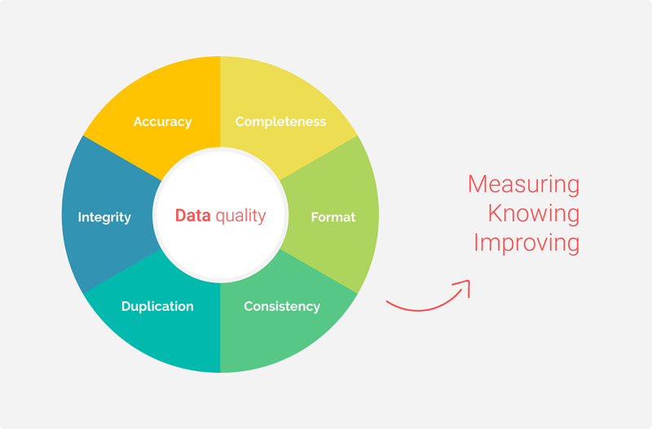
Image credit: Passionned Group

Slide 93
more data
balanced data
normalized data
quality data
Notes:
(click) Let’s focus first on adding more data (click).
if data isn’t perfect: small # of datapoints=more fluctuation, more datapoint s=less fluctuation

Slide 94
Missing Data

Slide 95
Missing completely at random
Missing Data
Missing at random
Missing not at random
Notes:
Ok, so after all this, what actually makes a model fit better? It all has to do with data. There’s a common principle in computer science: garbage in, garbage out. If you don’t have good inputs, then you shouldn’t expect your outputs to be any good either. You can get better inputs by (click) adding more data, (click) balancing your data, (click) or normalizing your data.

Slide 96
remove
Missing Data
Use mean/most often
regression
Notes:
Ok, so after all this, what actually makes a model fit better? It all has to do with data. There’s a common principle in computer science: garbage in, garbage out. If you don’t have good inputs, then you shouldn’t expect your outputs to be any good either. You can get better inputs by (click) adding more data, (click) balancing your data, (click) or normalizing your data.

Slide 97
more data
balanced data
normalized data
let’s clean some data!
Notes:
More Data: adding more data to your dataset to get a more accurate model
Balanced Data: making sure there’s even amounts of each type of data to get a more accurate model.
Normalized Data: making sure all your data points have values close to one another to get a more accurate model.
Now then, (click) let’s move on to with the lab

